Slide 1
AI & ML on Drug_DataSets
Presented by
Ajay Kumar Yadav

Slide 2
Overview
Expected delivery
March, 20,2022
Focus
Better decision on Drugs

Slide 3
Description of proposal
The role of machine learning and artificial intelligence is growing rapidly in many
aspects of drug discovery. These include: computational techniques such as
structure-based and ligand-based models for virtual screening to identify
compounds that bind to the target(s) of interest;

Slide 4
Description of proposal
in silico toxicology and adverse
drug-drug interaction prediction; and generative methods in de novo drug design.

Slide 5
Aim
This project will focus on virtual screening, developing models to help discover
new lead compounds and potential drugs, by classifying whether a small molecule
will bind to a therapeutic protein target; and regression models to predict how
tightly a compound will bind to a protein. You will develop models that will be
benchmarked against publicly-available datasets, such as DUD-E, DEKOIS 2.0,
(classification) and PDBbind (regression).

Slide 6
Tools & Libraries

Slide 7
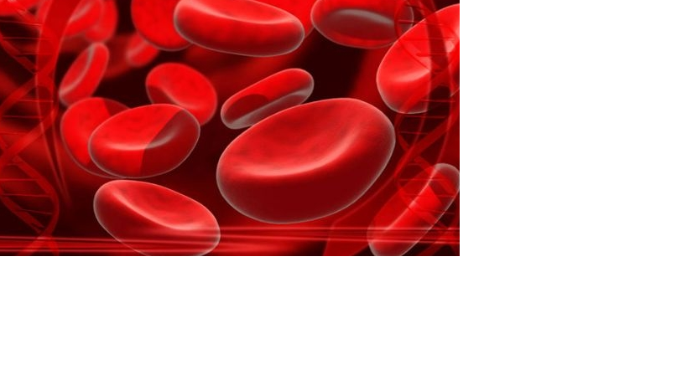
Python 3
Jupyter Notebook
Numpy
Pandas
Sklearn

Slide 8
Data Explorer:
110 MB
DrugComTest_raw 27.64 MB
DrugComTrain_raw 82.99 MB

Slide 9
UCI ML DRUG
Over 200,000 patient drug review

Slide 10
Tools
Jupyter Notebook
Web based platform
Python Libraries
Matplotlib 3D, Pandas, skLearn
Drug_Dataset
UCI drug dataset

Slide 11
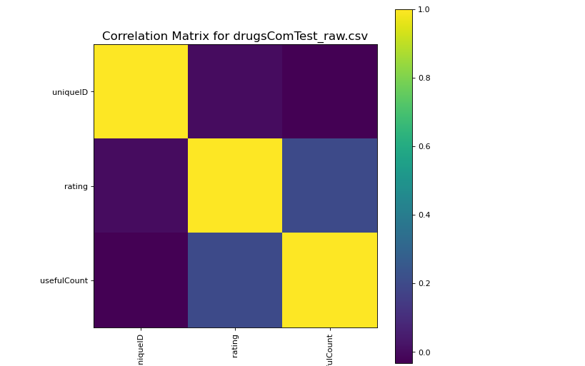
Results

Slide 12
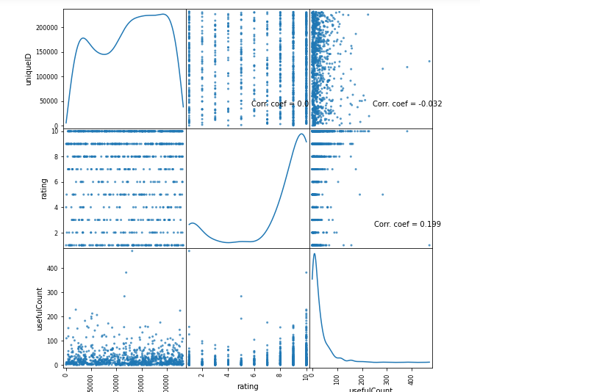
Results

Slide 13
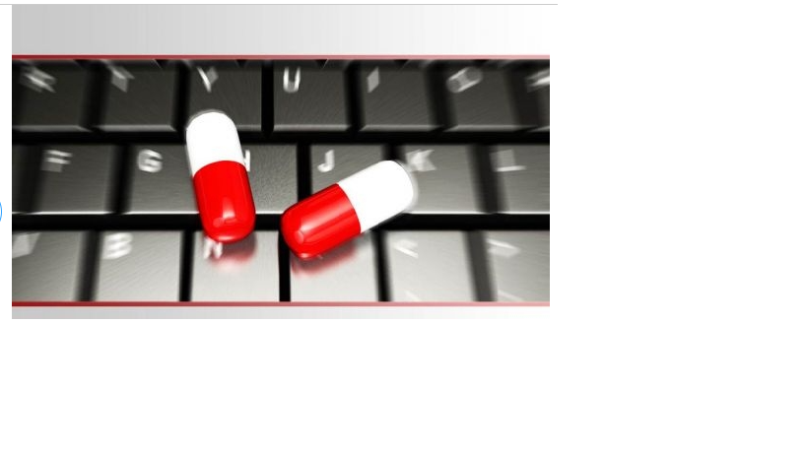
THANK YOU

